Slide 1

Supervised Learning

Slide 2
Warm ups
What are the various types of data
What is the difference between a sample and population
What is normal distribution
What is linear and non-linear relationships
What are outliers and its pros & cons

Slide 3
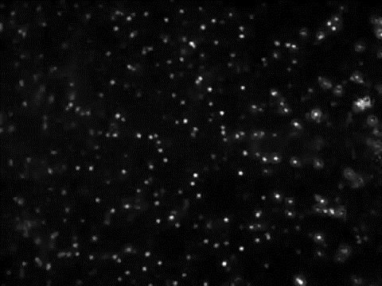
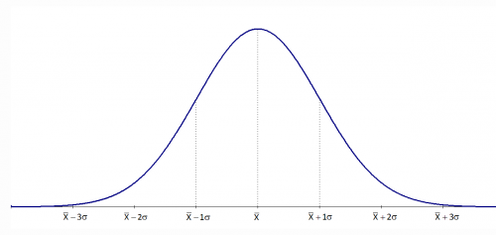
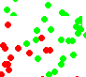
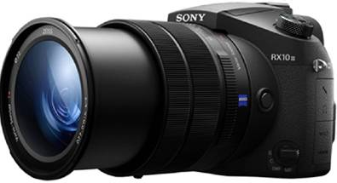
Sample Vs Population
Universe / Population
Time T1
Time T2
Sample / snapshot

Slide 4
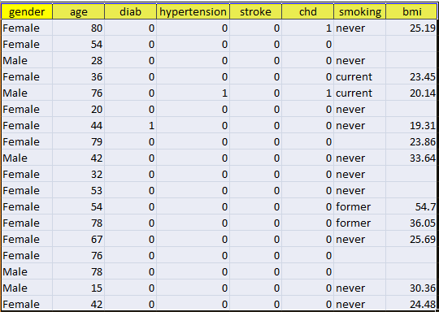
Real World as Mathematical Space
Each attribute becomes a dimension
Each record becomes a point in the space
Position of a point in space is defined with respect to the origin
The position is decided by the values of the attributes for a point
A model represents the real world process that generated the different set of data points
The model could be a simple plane, complex plane, hyper plane
But multiple planes can do the job. Each representing an alternate hypothesis
The learning algorithm selects that hypothesis which minimizes errors in the test data
In the figure, since the separator is a plane, the model will be the equation representing the plane
x , y, z represent the three dimensions i.e. BP, Age, Sugar while d represents the color i.e. healthy or ailing heart
The data point will be placed above or below the plane based on d
Sugar
Age
BP level
ax + by + cz = d
Heart healthy
Potential heart ailments

Slide 5
Real World as Mathematical Space
Sugar
ax + by + cz = d,
Age
BP level
Heart healthy
Erroneous classification
Potential heart ailments

Slide 6
Machine Learning Categories

Slide 7
Linear Regression

Slide 8
Linear Regression Models -
The term "regression" generally refers to predicting a real number. However, it can also be used for classification (predicting a category or class.)
The term "linear" in the name “linear regression” refers to the fact that the method models data with linear combination of the explanatory variables.
A linear combination is an expression where one or more variables are scaled by a constant factor and added together.
In the case of linear regression with a single explanatory variable, the linear combination used in linear regression can be expressed as:
response = intercept + constant ∗ explanatory
In its most basic form fits a straight line to the response variable. The model is designed to fit a line that minimizes the squared differences (also called errors or residuals.)
Before we generate a model, we need to understand the degree of relationship between the attributes Y and X
Mathematically correlation between two variables indicates how closely their relationship follows a straight line. By default we use Pearson’s correlation which ranges between -1 and +1.
Correlation of extreme possible values of -1 and +1 indicate a perfectly linear relationship between X and Y whereas a correlation of 0 indicates absence of linear relationship
When r value is small, one needs to test whether it is statistically significant or not to believe that there is correlation or not

Slide 9
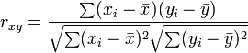
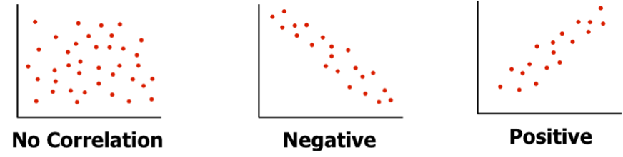
Linear Regression Models (Recap) -
Coefficient of relation - Pearson’s coefficient p(x,y) = Cov(x,y) / ( stnd Dev (x) X stnd Dev (y) )
Generating linear model for cases where r is near 0, makes no sense. The model will not be reliable. For a given value of X, there can be many values of Y! Nonlinear models may be better in such cases
r is near 0
r is near -1
r is near +1

Slide 10
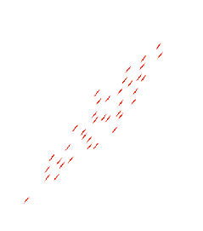
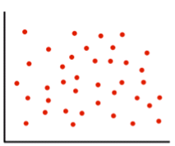
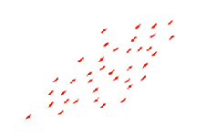
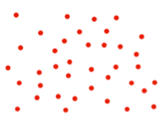
Linear Regression Models (Recap) -
Coefficient of relation - Pearson’s coefficient p(x,y) = Cov(x,y) / ( stnd Dev (x) X stnd Dev (y) )
- ve quad
+ve quad
+ve quad
- ve quad
= 0
> 0
http://www.socscistatistics.com/tests/pearson/Default2.aspx

Slide 11
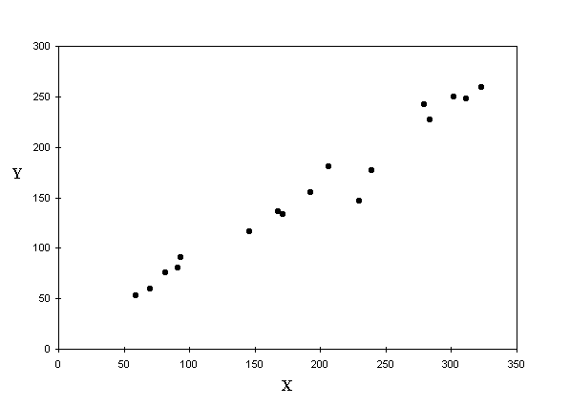
Linear Regression Models -
Given Y = f(x) and the scatter plot shows apparent correlation between X and Y Let’s fit a line into the scatter which shall be our model
But there are infinite number of lines that can be fit in the scatter. Which one should we consider as the model?
This and many other algorithms use gradient descent or variants of gradient descent method for finding the best model
Gradient descent methods use partial derivatives on the parameters (slope and intercept) to minimize sum of squared errors

Slide 12
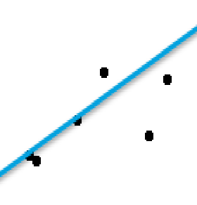
Linear Regression Models (Recap) -
Whichever line we consider as the model, it will not pass through all the points.
The distance between a point and the line (drop a line vertically (shown in yellow)) is the error in prediction
That line which gives least sum of squared errors is considered as the best line
Error = (T – (mx + C)
Sum of all errors can cancel out and give 0
We square all the errors and sum it up. That line which gives us least sum of squared errors is the best fit

Slide 13
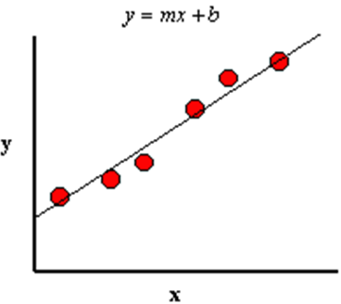
Linear Regression Models -
Coefficient of determinant – determines the fitness of a linear model. The closer the points get to the line, the R^2 (coeff of determinant) tends to 1, the better the model is
Model line always passes through Xbar and Ybar
Ybar
Xbar

Slide 14
Linear Regression Models -
Coefficient of determinant (Contd…)
There are a variety of errors for all those points that don’t fall exactly on the line.
It is important to understand these errors to judge the goodness of fit of the model i.e. How representative the model is likely to be in general
Let us look at point P1 which is one of the given data points and associated errors due to the model
P1 – Original y data point for given x
P2 - Estimated y value for given x
Ybar – Average of all Y values in data set
SST – Sum of Square error Total (SST) Variance of P1 from Ybar (Y – Ybar)^2
SSR - Regression error (p2 – ybar)^2 (portion SST captured by regression model)
SSE - Residual error (p1 – p2)^2
y
P1
SSE
SST
P2
SSR
Ybar
Xbar
x

Slide 15
Linear Regression Models -
Coefficient of determinant (Contd…)
That model is the most fit where every data point lies on the line. i.e. SSE = 0 for all data points
Hence SSR should be equal to SST i.e. SSR/SST should be 1.
Poor fit will mean large SSE. SSR/SST will be close to 0
SSR / SST is called as r^2 (r square) or coefficient of determination
r^2 is always between 0 and 1 and is a measure of utility of the regression model
y
P1
SSE
SST
P2
SSR
Ybar
Xbar
x

Slide 16
Linear Regression Models (Recap) -
Coefficient of determinant (Contd…) -
Point B
Point B
Point A
Point A
In case of point “A”, the line explains the variance of the point
Whereas point “B” the is a small area (light grey) which the line does not represent.
%age of total variance that is represented by the line is coeff of determinant

Slide 17
Linear Regression Model -
Advantages –
Simple to implement and easier to interpret the outputs coefficients
Disadvantages -
Assumes a linear relationships between dependent and independent variables. That is, it assumes there is a straight-line relationship between them
Outliers can have huge effects on the regression
Linear regression assume independence between attributes
Linear regression looks at a relationship between the mean of the dependent variable and the independent variables.
Just as the mean is not a complete description of a single variable, linear regression is not a complete description of relationships among variables
Boundaries are linear

Slide 18
Logistic Regression

Slide 19
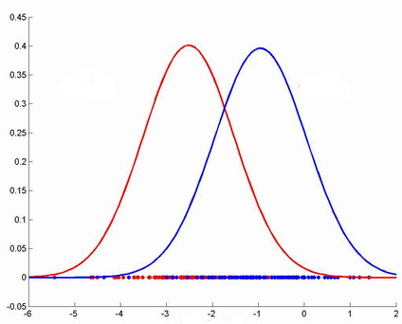
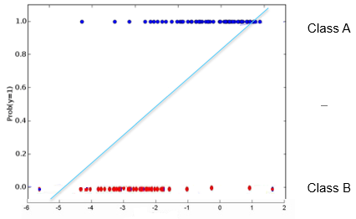
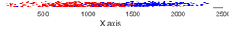
Logistic Regression Model
A classification method built on the same concept as linear regression. The response variable is categorical. In it’s simplest form, the response variable is binary i.e. belongs to one class or the other
Given the value of predictor (variable x), the model estimates the probability that the new data point belongs to a given class say “A”. Probability values can range between 0 and 1.
A new data point (shown with “?”) needs to be classified i.e. does it belong to class A or B.
Given the distribution, closer the point is to the origin, it is unlikely to belong to class A. Farther away it is from the origin, likely it belongs to class A
One can try to fit a simple linear model (y = mx +c) where y greater than a threshold means point most probably belongs to class A. The challenge is, for extreme values of x, probability is <0 or >1 which is absurd
Class B
Class A
Class B
Class A
Probability model
Density distribution

Slide 20
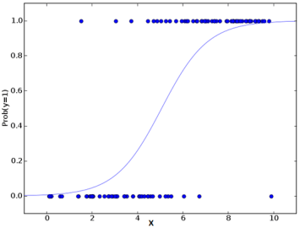
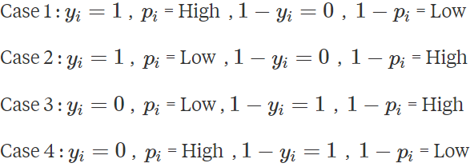
Logistic Regression Model -
The linear model is passed to a logistic function p = 1/ 1 + e^-t the result of which is values between 0 and 1. Thus p represents probability a data point belongs to class “A” given x
Uses logloss function to find the best fit line from the infinite possibilities where
The objective is to make logLoss as large negative number as possible
There can be four difference cases for the value of yi and pi
Incorrect classification contributes very minimal to the sum while a correct classification contributes large magnitudes
Class A
Correct classification
Incorrect classification
Correct classification
Incorrect classification
Class B
Note: The linear model t (which is of the form mx + c), represents logit which is natural log(p / 1-p) where p is probability that a data point belongs to a class or not

Slide 21
Logistic Regression Model -
In case1 y = 1 and p = high implies that we have got things right!. It significantly inflates the sum because, Yi * log (Pi) would be high while the other term in the would be zero since 1 - Yi = 1 - 1 = 0.
So more occurrences of Case 1 would inflate the sum and consequently inflate the mean
4
1
Class A
2
In case2, y = 1 and p is low which is incorrect classification. p = low, Yi * log (Pi) would not inflate the sum as much, the second term would be zero since 1- yi would be zero. So Case 2 would ultimately not affect the sum a lot.
Similarly the occurrences of Case 3 would inflate the sum significantly because first term would be 0 but second term will be high i.e. (1- yi)* log(1 – pi)
Case 4 first term will be 0 while in second term due to high pi, (1 – pi) will also be small hence contribution will be small
More of Case 1s and Case 3s increase the magnitude of the sum inside the logloss formula and because of the negative sign, make it overall error smaller and smaller
More Case2s and Case4s will not have as bit an impact on the overall value
The objective is to find the logistic curve that makes the overall logloss as negative as possible
3
Class B

Slide 22
Logistic Regression Model -
Advantages -
Makes no assumptions about distributions of classes in feature space
Easily extended to multiple classes (multinomial regression)
Natural probabilistic view of class predictions
Quick to train
Very fast at classifying unknown records
Good accuracy for many simple data sets
Resistant to overfitting
Can interpret model coefficients as indicators of feature importance
Dis advantages -
Constructs linear boundaries

Slide 23
K Nearest Neighbours

Slide 24
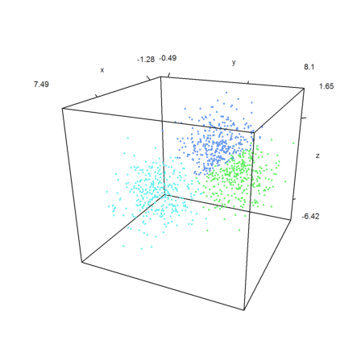
K Nearest Neighbors based classifications -
Is an instance-based learning or non-generalizing learning. It does not construct a general internal model
Classification is computed from a simple majority vote of the nearest neighbors of each point
New data point is assigned a class which has the most data points in the nearest neighbors of the point
Suited for classification where relationship between features and target classes is numerous, complex and difficult to understand and yet items in a class tend to be fairly homogenous on the values of attributes
Not suitable if the data is noisy and the target classes do not have clear demarcation in terms of attribute values
The training data is represented by the scattered data points in the feature space
The color of the data points indicate the class they belong to
The grey point is the query point who's class has to be fixed

Slide 25
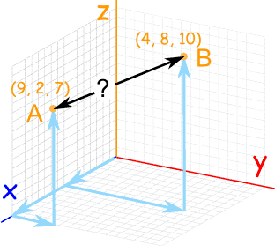
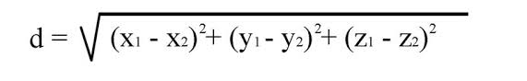
K Nearest Neighbors based classifications -
Measuring similarity with distance between the points using Euclidian method
Other distance measurement methods include Manhattan distance, Minkowski distance, Mahalanobis distance, Bhattacharya distance etc.
Scikit-learn implements two different nearest neighbors classifiers – K Nearest Neighbor Classifier and Radius Neighbor Classifier
Radius Neighbor Classifier implements learning based on number of neighbors within a fixed radius r of each training point, where r is a floating point value specified by the user
Determining the optimal K is the challenge in K Nearest Neighbor classifiers. In general, larger value of K suppresses impact of noise but prone to majority class dominating
Radius Neighbor Classifier may be a better choice when the sampling is not uniform. However, when there are many attributes and data is sparse, this method becomes ineffective due to curse of dimensionality
Ref: http://scikit-learn.org/stable/modules/neighbors.html#classification

Slide 26
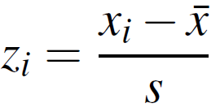
K Nearest Neighbors based classifications -
The Neighbors based algorithm can also be used for regression where the labels are continuous data and the label of query point can be average of the labels of the neighbors
The approach to find nearest neighbors using distance between the query point and all other points is called the brute force. Becomes time costly (O(N^2) ) and inefficient with increase in number of points
KD Tree based nearest neighbor approach helps reduce the time from the order of N^2 to DNlogN where D is number of dimensions. This methods becomes ineffective when D is large dur to curse of dimensionality
The distance formula is highly dependent on how features / attributes / dimensions are measured.
Those dimensions which have larger possible range of values will dominate the result of the distance calculation using Euclidian formula
To ensure all the dimensions have similar scale, we normalize the data on all the dimensions / attributes
There are multiple ways of normalizing the data. We will use Z-score standardization

Slide 27
Similarity
Numerical measure of how alike two data objects are
Value is higher when objects are more alike
Often falls in the range [0,1]
Dissimilarity (e.g., distance)
Numerical measure of how different two data objects are
Lower when objects are more alike
Minimum dissimilarity is often 0
Upper limit varies
Proximity refers to a similarity or dissimilarity
Properties of Distance Measures:
for all objects A and B, dist(A, B) ≥ 0, and dist(A, B) = dist(B, A)
for any object A, dist(A, A) = 0
dist(A, C) ≤ dist(A, B) + dist (B, C)
Representation of objects as vectors:
Each data object (item) can be viewed as an n-dimensional vector, where the dimensions are the attributes (features) in the data
Example (employee DB): Emp. ID 2 = <M, 51, 64000>
Example (Documents): DOC2 = <3, 1, 4, 3, 1, 2>
The vector representation allows us to compute distance or similarity between pairs of items using standard vector operations, e.g.,
Cosine of the angle between vectors
Manhattan distance
Euclidean distance
Hamming Distance
Source: Distance and Similarity Measures - Bamshad Mobasher DePaul University

Slide 28
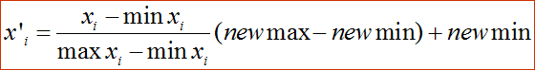
Normalizing or Standardizing Numeric Data
Z-score:
x: raw value to be standardized, μ: mean of the population, σ: standard deviation
the distance between the raw score and the population mean in units of the standard deviation
negative when the value is below the mean, “+” when above
Min-Max Normalization
Source: Distance and Similarity Measures - Bamshad Mobasher DePaul University

Slide 29
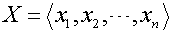
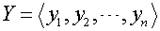
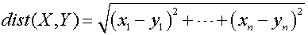
Common Distance Measures for Numeric Data
Consider two vectors
Rows in the data matrix
Common Distance Measures:
Manhattan distance:
Euclidean distance:
Distance can be defined as a dual of a similarity measure
Source: Distance and Similarity Measures - Bamshad Mobasher DePaul University

Slide 30
Example: Data Matrix and Distance Matrix
Data Matrix
Distance Matrix (Manhattan)
Distance Matrix (Euclidean)
Source: Distance and Similarity Measures - Bamshad Mobasher DePaul University

Slide 31
Distance on Numeric Data: Minkowski Distance
Minkowski distance: A popular distance measure
where i = (x_{i1}, x_{i2}, …, x_{ip}) and j = (x_{j1}, x_{j2}, …, x_{jp}) are two p-dimensional data objects, and h is the order (the distance so defined is also called L-h norm)
Note that Euclidean and Manhattan distances are special cases
h = 1: (L₁ norm) Manhattan distance
h = 2: (L₂ norm) Euclidean distance
Source: Distance and Similarity Measures - Bamshad Mobasher DePaul University

Slide 32
Vector-Based Similarity Measures
In some situations, distance measures provide a skewed view of data
E.g., when the data is very sparse and 0’s in the vectors are not significant
In such cases, typically vector-based similarity measures are used
Most common measure: Cosine similarity
Dot product of two vectors:
Cosine Similarity = normalized dot product
the norm of a vector X is:
the cosine similarity is:
Source: Distance and Similarity Measures - Bamshad Mobasher DePaul University

Slide 33
Vector-Based Similarity Measures
Why divide by the norm?
Example:
X = <2, 0, 3, 2, 1, 4>
||X|| = SQRT(4+0+9+4+1+16) = 5.83
X* = X / ||X|| = <0.343, 0, 0.514, 0.343, 0.171, 0.686>
Now, note that ||X*|| = 1
So, dividing a vector by its norm, turns it into a unit-length vector
Cosine similarity measures the angle between two unit length vectors (i.e., the magnitude of the vectors are ignored).
Source: Distance and Similarity Measures - Bamshad Mobasher DePaul University

Slide 34
Example Application: Information Retrieval
Documents are represented as “bags of words”
Represented as vectors when used computationally
A vector is an array of floating point (or binary in case of bit maps)
Has direction and magnitude
Each vector has a place for every term in collection (most are sparse)
Document Ids
a document
vector
nova galaxy heat actor film role
A 1.0 0.5 0.3
B 0.5 1.0
C 1.0 0.8 0.7
D 0.9 1.0 0.5
E 1.0 1.0
F 0.7
G 0.5 0.7 0.9
H 0.6 1.0 0.3 0.2
I 0.7 0.5 0.3
Source: Distance and Similarity Measures - Bamshad Mobasher DePaul University

Slide 35
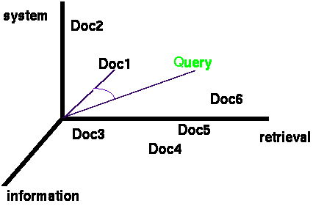
Documents & Query in n-dimensional Space
Documents are represented as vectors in the term space
Typically values in each dimension correspond to the frequency of the corresponding term in the document
Queries represented as vectors in the same vector-space
Cosine similarity between the query and documents is often used to rank retrieved documents
Source: Distance and Similarity Measures - Bamshad Mobasher DePaul University

Slide 36
Example: Similarities among Documents
Consider the following document-term matrix
Dot-Product(Doc2,Doc4) = <3,1,4,3,1,2,0,1> * <0,1,0,3,0,0,2,0>
0 + 1 + 0 + 9 + 0 + 0 + 0 + 0 = 10
Norm (Doc2) = SQRT(9+1+16+9+1+4+0+1) = 6.4
Norm (Doc4) = SQRT(0+1+0+9+0+0+4+0) = 3.74
Cosine(Doc2, Doc4) = 10 / (6.4 * 3.74) = 0.42
Source: Distance and Similarity Measures - Bamshad Mobasher DePaul University

Slide 37
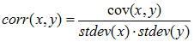
Correlation as Similarity
In cases where there could be high mean variance across data objects (e.g., movie ratings), Pearson Correlation coefficient is the best option
Pearson Correlation
Often used in recommender systems based on Collaborative Filtering
Source: Distance and Similarity Measures - Bamshad Mobasher DePaul University

Slide 38
Distance-Based Classification
Basic Idea: classify new instances based on their similarity to or distance from instances we have seen before
also called “instance-based learning”
Simplest form of MBR (Memory Based Reasoning): Rote Learning
learning by memorization
save all previously encountered instance; given a new instance, find one from the memorized set that most closely “resembles” the new one; assign new instance to the same class as the “nearest neighbor”
more general methods try to find k nearest neighbors rather than just one
but, how do we define “resembles?”
MBR is “lazy”
defers all of the real work until new instance is obtained; no attempt is made to learn a generalized model from the training set
less data preprocessing and model evaluation, but more work has to be done at classification time
Source: Distance and Similarity Measures - Bamshad Mobasher DePaul University

Slide 39
Will a new customer
respond to solicitation?
Using the voting method without confidence
Using the voting method with a confidence
Source: Distance and Similarity Measures - Bamshad Mobasher DePaul University

Slide 40
K Nearest Neighbors based classifications -
Advantages -
Makes no assumptions about distributions of classes in feature space
Can work for multi classes simultaneously
Easy to implement and understand
Not impacted by outliers
Dis-advantages -
Fixing the optimal value of K is a challenge
Will not be effective when the class distributions overlap
Does not output any models. Calculates distances for every new point (lazy learner)
Computationally intensive (O(D(N^2))), can be addressed using KD algorithms which take time to prepare

Slide 41
Modelling Errors

Slide 42
Modelling Errors
All models are impacted by three types of errors which reduce their predicting power.
Variance errors
Bias error
Random errors
Variance errors
Caused by the random factors that impact the process that generate the data
The population / universe, representing the infinite data points continuously jiggle
Sample drawn from such universe is a snapshot of a small part of the universe
The model based on a sample will perform differently on different samples
Variance errors increase with increase in number of attributes in the model due to increase in degrees of freedom for the data points to wriggle in
Bias errors
Caused by our selection of the attributes and our interpretation of their influence on each other
The real model in the universe / population may have many more attributes and the attributes interacting in different ways not reflected in our model
Random errors
Caused by unknown factors. They cannot be modelled

Slide 43
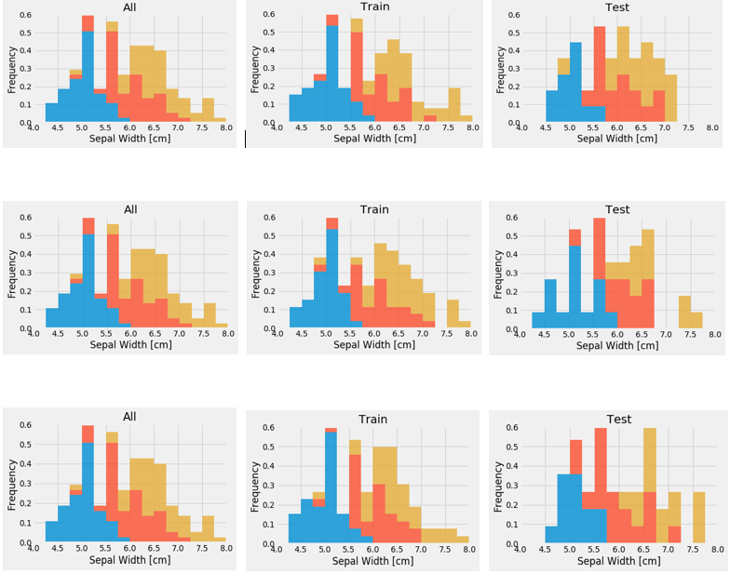
Modelling Errors Visaual demo of variance in training and test data
Sample Data (Analytics Base Table)
Three Random Training Sets From ABT
Three Random Test Sets From ABT

Slide 44
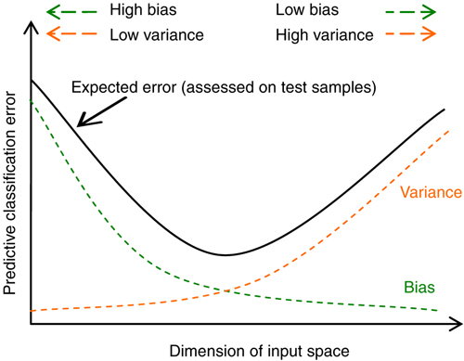
Modelling Errors
We have to find the right attributes and the right number of dimensions such that the total effect of these two (indicated by black curve) minimizes.
The gap between variance curve and total error curve reflects presence of random errors in the model

Slide 45
Fitness of a Model
Generalize
Models are expected to perform well (meet least accuracy thresholds) in production (real world data)
But data in real world is under flux / jiggle
Models have to perform in this context of continuous jiggle. Such models are said to generalize well
For models to generalize well, they should neither be underfit or overfit in the training data
Underfit models
Models that are over simplified i.e. models in which the independent and dependent attributes interact in a simple linear way ( can be expressed in a linear form for e.g. y = mx + c).
The model could have been addressed as a quadratic form such as y = m1x + m2 x^2 +C
Underfit models result in errors as they fail to capture the complex interactions among the attributes in the real world
These models will not generalize in the real world
Overfit models
Models that perform very well (sometimes with zero errors) in training data
Are complex polynomial surfaces that twist and turn in the feature space to cleanly separate the classes
Adjust to the variance in the training data i.e. try to adjust to the positions of the data points though those positions are not the expected values of the data points (mean of the jiggle)
These models adapt to the variance error in the data set and will not generalize in the real world

Slide 46
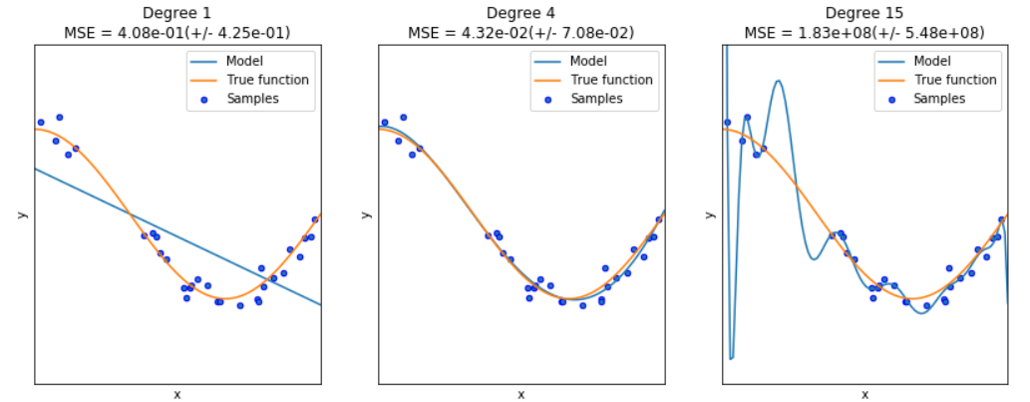
Fitness of a Model
Under Fit
Good Fit
Over Fit
When the interaction between the attributes and target dimensions are oversimplified. Fail to generalize
Right fit. Will generalize relatively much better
When the interaction between the attributes and target dimensions are overly complex in the model. Fail to generalize

Slide 47
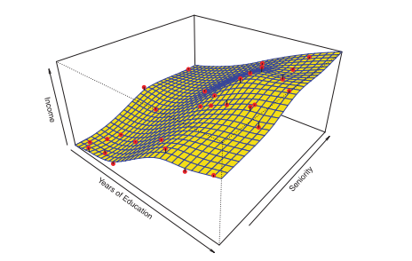
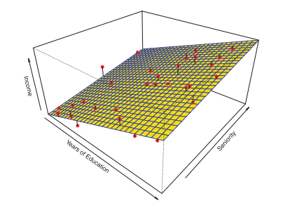
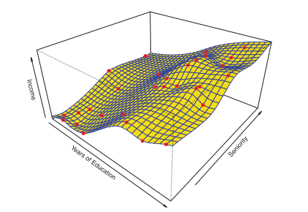
Good fit
Over fit
Underfit
In overfit models, the models absorb the noise (variance) in the data points achieving almost 100% accuracy in controlled environment. But when used in production (where the data points have different variance, the models will perform poorly

Slide 48
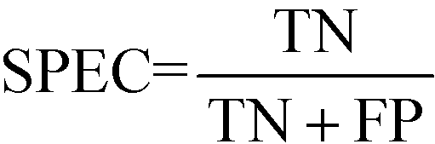
Model performance measures
Confusion Matrix – A 2X2 tabular structure reflecting the performance of the model in four blocks
Accuracy – How accurately / cleanly does the model classify the data points. Lesser the false predictions, more the accuracy
Sensitivity / Recall – How many of the actual True data points are identified as True data points by the model . Remember, False Negatives are those data points which should have been identified as True.
Specificity – How many of the actual Negative data points are identified as negative by the model
Precision – Among the points identified as Positive by the model, how many are really Positive
Confusion Matrix | Predicted Positive | Predicted Negative
Actual Positive | True Positive | False Negative
Actual Negative | False Positive | True Negative

Slide 49
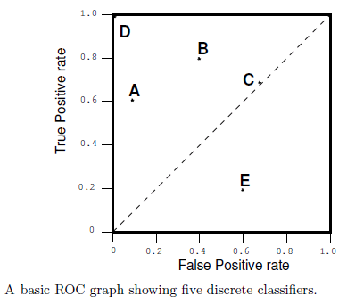
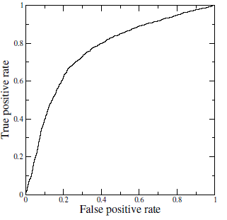
Receiver Operating Characteristics (ROC) Curve
A technique for visualizing classifier performance
It is a graph between TP rate and FP rates
TP rate = TP / total positive
FP rate = FP / total negative
ROC graph is a trade off between benefits (TP) and costs (FP)
The point (0,1) represents perfect classified (e.g. D)
TP = 1 and FP = 0
Classifiers very close to Y axis and lower (nearer to x axis) are conservative models and strict in classifying positives (low TP rate)
Classifiers on top right are liberal in classifying positives hence higher TP rate and FP rate

Slide 50
Decision Trees

Slide 51
Decision Trees -
Classifiers utilize a tree structure to model relationships among the features and the potential outcomes
Decision trees consist of nodes and branches. Nodes represent a decision function while branch represents the result of the function. Thus it is a flow chart for deciding how to classify a new observation:
The nodes are of three types, Root Node (representing the original data), Branch Node (representing a function), Leaf Node (which holds the result of all the previous functions that connect to it)
For classification problem, the posterior probability of all the classes is reflected in the leaf node and the Leaf Node belongs to the majority class.
After executing all the functions from Root Node to Leaf Node, the class of a data point is decided by the leaf node to which it reaches
For regression, the average/ median value of the target attribute is assigned to the query variable
Tree creation splits data into subsets and subsets into further smaller subsets. The algorithm stops splitting data when data within the subsets are sufficiently homogenous or some other stopping criterion is met
The decision tree algorithm learns (i.e. creates the decision tree from the data set) through optimization of a loss function
The loss function represents the loss of impurity in the target column. The requirement here is to minimize the impurity as much as possible at the leaf nodes
Purity of a node is a measure of homogeneity in the target column at that node

Slide 52
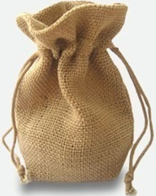
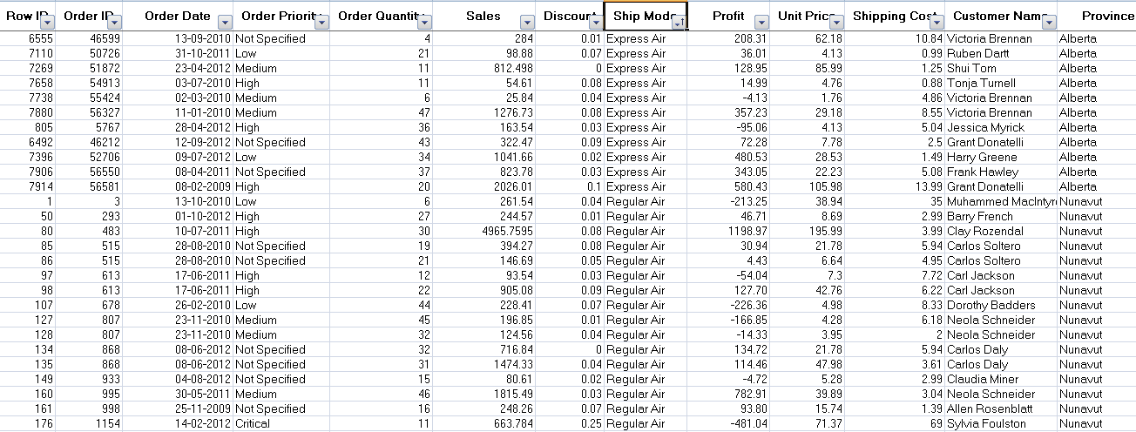
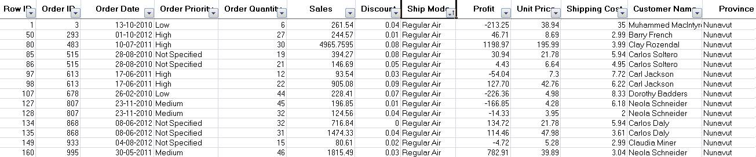
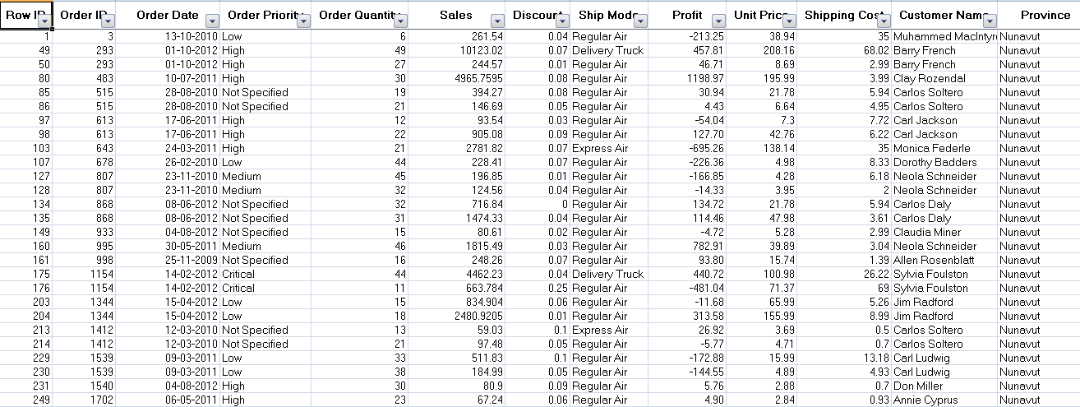
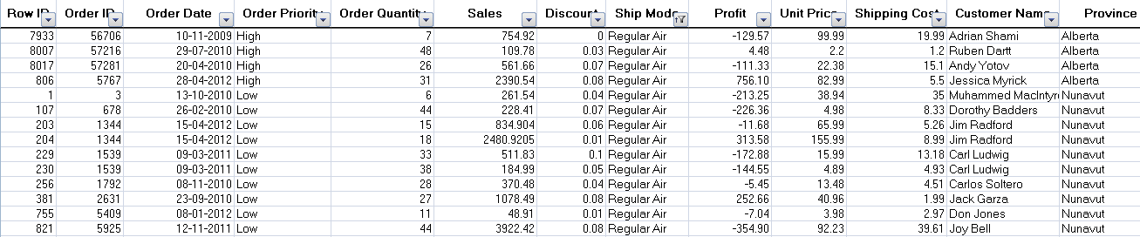
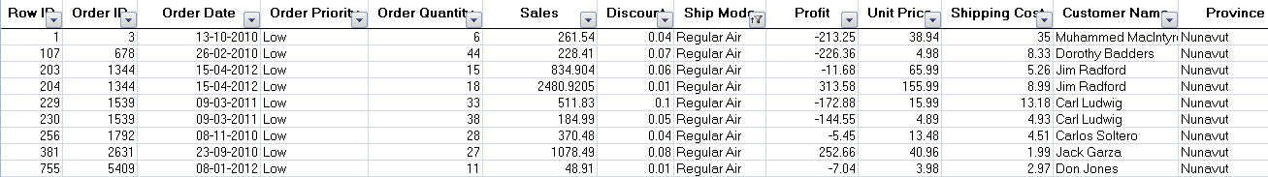
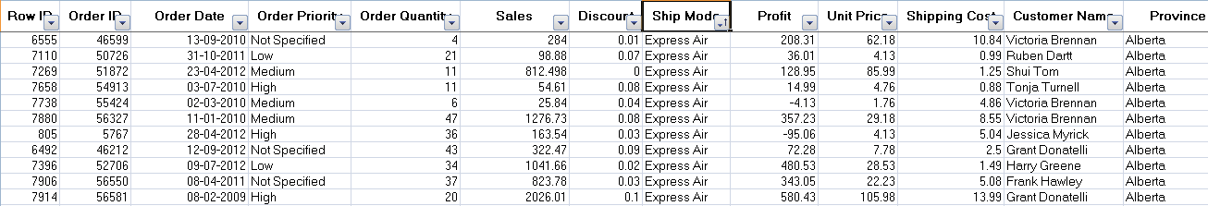
Decision Trees -
Suppose we wish to find if there was any influence of shipping mode, order priority on customer location. Customer location is target column and like the bag of coloured balls
Shipping Mode
Sales
Data
Regular Air
ExpressAir
Low Priority
High Priority
When sub branches are created, the total entropy of the sub branches should be less than the entropy of the parent node. More the drop in entropy, more the information gained

Slide 53
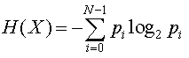
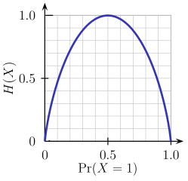
Decision Trees – Shannon's Entropy
Imagine a bag contains 6 red and 4 black balls.
Let the two classes Red -> class 0 and Black -> class 1
Entropy of the bag (X) will be calculated as per the formula
H(X) = - (0.6 * log2( 0.6)) - (0.4 * log2(0.4)) = 0.9709506
Suppose we remove all red balls from the bag and then entropy will be
H(X) = - 1.0 *log2(1.0) – 0.0 * log2(0) = 0 ## Entropy is 0! i.e. Information is 100%

Slide 54
Decision Trees -
Entropy | Info Gain
E0 = max entropy say 1 | 0
E1 = (E1a*700/1000) + (E1b * 300/1000) | E0 – E1
E2 = (E2a * 500/700) + (E2b * 200/700) + (E2c * 100/300) + (E2d * 200/300) | E1 – E2
Shipping
Mode (1000) E0
Regular Air (700), E1a
Express Air (300), E1b
Low Priority (500) E2a
High Priority (200) E2b
Low Priority (100) E2c
High Priority (200) E2d
Tree will stop growing when stop criterion for the splitting is reached which could be -
Tree has reached certain pre-fixed depth (longestt path from root node to leaf node)
Tree has achieve maximum number of nodes (tree size)
Exhausted all attributes to split
Leaf node on split will have less than predefined number of data points

Slide 55
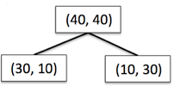
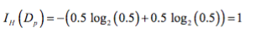
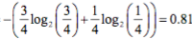


Decision Trees - Information Gain using Entropy
Information Gain = reduction in entropy =

Slide 56




Decision Trees - Information Gain using Gini index
Information Gain = reduction in Gini index =

Slide 57

Decision Trees -
Common measures of purity
Gini index – is calculated by subtracting the sum of the squared probabilities of each class from one
Uses squared proportion of classes
Perfectly classified, Gini Index would be zero
Evenly distributed would be 1 – (1/# Classes)
You want a variable split that has a low Gini Index
Used in CART algorithm
Entropy –
Favors splits with small counts but many unique values
Weights probability of class by log(base=2) of the class probability
A smaller value of Entropy is better. That makes the difference between the parent node’s entropy larger
Information Gain is the Entropy of the parent node minus the entropy of the child nodes

Slide 58

Decision Trees – Gini , Entropy , Misclassification Error
Note: Misclassification Error is not used in Decision Trees

Slide 59
Decision Trees - Algorithms
ID3 (Iterative Dicotomizer 3) – developed by Ross Quinlan. Creates a multi branch tree at each node using greedy algorithm. Trees grow to maximum size before pruning
C4.5 succeeded ID3 by overcoming limitation of features required to be categorical. It dynamically defines discrete attribute for numerical attributes. It converts the trained trees into a set of if-then rules. Accuracy of each rule is evaluated to determine the order in which they should be applied
C5.0 is Quinlan’s latest version and it uses less memory and builds smaller rulesets than C4.5 while being more accurate
CART (Classification & Regression Trees) is similar to C4.5 but it supports numerical target variables and does not compute rule sets. Creates binary tree. Scikit uses CART

Slide 60
Decision Trees -
Advantages -
Simple , Fast in processing and effective
Does well with noisy data and missing data
Handles numeric and categorical variables
Interpretation of results does not required mathematical or statistical knowledge
Dis-advantages -
Often biased towards splits or features have large number of levels
May not be optimum as modelling some relations on axis parallel basis is not optimal
Small changes in training data can result in large changes to the logic
Large trees can be difficult to interpret

Slide 61
Decision Trees - Preventing overfitting through regularization
Decision trees do not assume a particular form of relationship between the independent and dependent variables unlike linear models for e.g.
DT is a non-parametrized algorithm unlike linear models where we supply the input parameters
If left unconstrained, they can build tree structures to adapt to the training data leading to overfitting
To avoid overfitting, we need to restrict the DT’s freedom during the tree creation. This is called regularization
The regularization hyperparameters depend on the algorithms used

Slide 62
Decision Trees - Regularization parameters
max_depth – Is the maximum length of a path from root to leaf (in terms of number of decision points. The leaf node is not split further. It could lead to a tree with leaf node containing many observations on one side of the tree, whereas on the other side, nodes containing much less observations get further split
min_sample_split - A limit to stop further splitting of nodes when the number of observations in the node is lower than this value
min_sample_leaf – Minimum number of samples a leaf node must have. When a leaf contains too few observations, further splitting will result in overfitting (modeling of noise in the data).
min_weight_fraction_leaf – Same as min_sample_leaf but expressed in fraction of total number of weighted instances
max_leaf_nodes – maximum number of leaf nodes in a tree
max_feature_size - max number of features that are evaluated for splitting each node

Slide 63
Ensemble Methods

Slide 64
Ensemble Methods -
To combine the predictions of several base estimators built with a given learning algorithm in order to improve generalizability / robustness over a single estimator
Two families of ensemble methods are usually distinguished:
Averaging methods, the driving principle is to build several estimators independently and then to average / vote their predictions. On average, the combined estimator is usually better than any of the single base estimator because its variance is reduced.
E.g. Bagging methods, Forests of randomized trees, ...
Boosting methods, base estimators are built sequentially and one tries to reduce the bias of the combined estimator. The motivation is to combine several weak models to produce a powerful ensemble. E.g. AdaBoost, Gradient Tree Boosting, ...

Slide 65

Ensemble Methods -
In the final stage of voting, we essentially have a combined surface resulting from individual surfaces
Source: https://github.com/MenuPolis/MLT/wiki/Bagging

Slide 66
Ensemble Methods –
Focus of ensemble techniques is to generate a set of models & predict by aggregating output of the models
Ensemble prediction model consists of a set of models
Motivation for ensemble is wisdom of the crowds. Combine multiple weak learners to create an overall strong predictor
All ensemble methods can be analyzed at a high level on the basis of –
How the algorithms for weak learning models are chose – (same or different)
How data is allocated to the various instances of the weak learners
How the weak learners predictions are combine to make a final prediction
Notes:
Bagging methods come in different flavours but mostly differ by the way they draw random subsets of the training set
When random subsets of the data set are drawn as random subsets of the samples, the algorithm is known as pasting
When samples are drawn with replacement, the method is known as Bagging (Bootstrap Aggregation)
When the random subsets of the dataset are drawn as random subsets of the features, then the method is known as random subspaces
When the base estimators are built on subsets of both samples and features, the method is called random patches
Source: Scikit-learn user guide, chapter 3, page 230

Slide 67
Ensemble Methods Block View
The allocation function decides how much training data each model instance receives
Do they get full set each as in stacking
Do they get a sample as in bagging
Do they get all the features or subset of features (random patches)
Ideal ensemble consists of diverse set of models, the allocation function can increase diversity by artificially varying the input data to bias the learners. This increase diversity even if all the instances are based on same algorithm
It may bootstrap sample to construct unique training data set
Pass a different subset of features
Different data with different subset features
If the ensemble already includes a diverse set of algorithms such as ANN, KNN, NB etc), the allocation function may allocate same data to all (Stacking)
The combination function governs how the disagreement among the predictors are reconciled
Majority vote - hard and soft
Weighted vote – each model instance gets a weight attached based on its performance
M1
Combination function
Allot data
M2
Training Data
M3
Notes:
Bagging methods come in different flavours but mostly differ by the way they draw random subsets of the training set
When random subsets of the data set are drawn as random subsets of the samples, the algorithm is known as pasting
When samples are drawn with replacement, the method is known as Bagging (Bootstrap Aggregation)
When the random subsets of the dataset are drawn as random subsets of the features, then the method is known as random subspaces
When the base estimators are built on subsets of both samples and features, the method is called random patches
Source: Scikit-learn user guide, chapter 3, page 230

Slide 68
Ensemble Methods Benefits
Spend less time in pursuit of a single best model. Instead, train a number of reasonably strong learners
Better generalizability in real world. Bias of individual models is averaged out while lowering the variance errors
Improved performance compared to individual models in terms of performance Vs time to prepare
Many models run into memory or computational limits when working with large data sets (both in volume and breadth). Instead train several simple models on smaller data
Can handle complex data patterns easily than a fully loaded single model
Notes:
Bagging methods come in different flavours but mostly differ by the way they draw random subsets of the training set
When random subsets of the data set are drawn as random subsets of the samples, the algorithm is known as pasting
When samples are drawn with replacement, the method is known as Bagging (Bootstrap Aggregation)
When the random subsets of the dataset are drawn as random subsets of the features, then the method is known as random subspaces
When the base estimators are built on subsets of both samples and features, the method is called random patches
Source: Scikit-learn user guide, chapter 3, page 230

Slide 69
Ensemble Methods – Bagging (Bootstrap Aggregation) :
Generate a number of training data sets using bootstrap sampling from the original data
Training sets are used to generate a set of models using single learning algorithm
Model predictions are combined using voting for classification, averaging for regression
Sampling with replacement result in duplicates within a data set. For large sample size, sample data is expected to have roughly 63.2% ( 1 – 1/e) unique data points and the rest being duplicates
Consequently, every bootstrap sample will be missing some of the instances from the original data set and as a result each bootstrap sample lead to a different model
Decision trees are specifically suited for bagging ensemble. A small change in the data will generate completely different trees (diff features may be selected for the split in different order)
Notes:
Bagging methods come in different flavours but mostly differ by the way they draw random subsets of the training set
When random subsets of the data set are drawn as random subsets of the samples, the algorithm is known as pasting
When samples are drawn with replacement, the method is known as Bagging (Bootstrap Aggregation)
When the random subsets of the dataset are drawn as random subsets of the features, then the method is known as random subspaces
When the base estimators are built on subsets of both samples and features, the method is called random patches
Source: Scikit-learn user guide, chapter 3, page 230

Slide 70

Ensemble Methods – Bagging (Bootstrap Aggregation) :
Re-sampling done for every classifier using a random function. For large n, 63.2% unique samples likely to be selected
Voting could be simple or weighted
Algorithm to generate classifiers. Could be Decision Tree, Naïve Bayes etc
K classifiers created in parallel and independently on respective training data
Source: https://link.springer.com/article/10.1007/s13721-013-0034-x

Slide 71
Ensemble Methods – Bagging (Bootstrap Aggregation) :
With bagging some instances may be sampled several times for a given predictor while other instances my not be sampled at all
If original data set : X = (x1, x2, ….x100) and boot_1 = sample (X, 100, replace = true) will generate a data set boot_1 of 100 data points but pick the data from X in random way with replacement
Chance of a record getting selected = 1/n
Chance of not getting selected = 1 – 1/n
Probability of a record not getting selected at all = (1 – 1/n) ^n
When n -> infinity, (1 – 1/n)^n -> 1/e = 37%, hence, only 63% of data get selected
Samples left out of the bag (not considered at all) can be used for evaluation of the ensemble
Notes:
Bagging methods come in different flavours but mostly differ by the way they draw random subsets of the training set
When random subsets of the data set are drawn as random subsets of the samples, the algorithm is known as pasting
When samples are drawn with replacement, the method is known as Bagging (Bootstrap Aggregation)
When the random subsets of the dataset are drawn as random subsets of the features, then the method is known as random subspaces
When the base estimators are built on subsets of both samples and features, the method is called random patches
Source: Scikit-learn user guide, chapter 3, page 230

Slide 72
Ensemble Methods – Boosting:
So called because it boosts the performance of weak learners to attain performance of stronger learners
Similar to bagging, it uses ensemble of models trained on resampled data and a vote to determine the final prediction
It combines models of the same type
Explicitly seeks modes that complement one another. i.e. where one model fails, the subsequent one pitches in
It is an iterative method i.e. the models are created in a sequence. Not in parallel as in bagging
Each new model is influenced by performance of the previous model performance
It encourages new models to become experts for instances handled incorrectly by earlier one by assigning greater weight to those erroneous instances
Boosting also assigns weights to the various model instances based on the instances contribution to ensemble
Since the models in the ensemble are built to be complimentary, it is possible to increase ensemble performance to an arbitrarily very high number by adding more and more predictor (may lead to overfitting)

Slide 73
Ensemble Methods – AdaBoosting :
Used for classification where every instance is given a non zero weight
Beginning with unweighted (equal weight) data, the first classifier attempts to model the outcome
Observations which the classifier predicted correctly, will be less likely to appear in the training set for the following classifier, conversely, the difficult to classify examples will appear more frequently
The subsequent rounds of weak learners are trained on difficult to classify data
The process continues until desired level of accuracy threshold is achieved
Though boosting can be used for any type of classifier, it is mostly used for decision tree

Slide 74
Ensemble Methods – AdaBoosting mechanics:
The adaboost_M1 begins by assigning equal weights to all data points
It builds the first learner and re-weights each instance based on the classifier output
Weights of correctly classified records are decreased and
Weights of incorrectly identified ones are increased.
This produces a set of “easy” instances with low weights and a set of “hard” ones with high weights
In the subsequent iteration, a classifier is built for the re-weighted data that focuses on classifying the hard instances correctly
As a result of reweighting, some hard instances may become harder, some hard instances can become easier and some easier instances may become harder
How much should the weight change? Depends upon current classifier’s overall error. If “e” denotes classifier error records over total records (ranges between 0 and 1), then
Weight <- weight X e/(1-e) for correctly classified instances

Slide 75
Ensemble Methods – AdaBoosting mechanics:
After all the weights have been updated for correctly classified records, they are re-normalized so that the sum of weights remain same as before
Classifiers that perform well on the weighted training data from where it was built, receives highest weight
Boosting give more accurate results than bagging but at the risk of overfitting

Slide 76

Ensemble Methods – AdaBoosting:
Training data from base data with focus on instances which were incorrectly classified by earlier model (if any)
Voting could be simple or weighted
K similar classifiers created in sequence with respective training data with focus on addressing the misclassified data, not the usual cost functions
It is called Adaptive Boosting as the weights are re-assigned to each instance, with higher weights to incorrectly classified instance
Source: https://link.springer.com/article/10.1007/s13721-013-0034-x

Slide 77

Ensemble Methods – AdaBoosting :
Adapting weights with focus on erroneously classified instances
Initialize weights, equal weights to all instances
Generate first classifier with equal focus on all instances
Total up weights of all error instances, express it as a ratio to total weights
If error ratio is > 50%
Calculate predictor weights (i.e. weight of the classifier)
Assign new weights to instances misclassified, else keep the weights same
Renormalize the weights across all the instances and fit next classifier
For a test instance use weighted voting to identify the class

Slide 78
Ensemble Methods – Gradient Boosting :
Idea is to build a simple model say … y = f1(x) + e1
Next iteration build a model to predict e1 i.e. Y = f1(x) + f2(x) + e2. This f2 in this iteration leaves it’s own residuals
Next iteration build a model to predict e2. Y = f1(x) + f2(x) + f3(x) + e3….
We can keep adding models to predict the residuals
Thus gradient boosting yields additive ensemble models
By fitting new models to the residuals, the overall learner gradually improves in areas where residuals are initially high
To prevent overfitting, the effect of subsequent models have to be dampened by introducing a concept of step towards minimising the residuals
In general the step size is not enough to prevent overfitting. Another parameter called regularization is used
Smaller the eta value, lesser the chances of overfit

Slide 79
Ensemble Methods – Gradient Boosting :
Advantages :
One of the most accurate ensemble methods. Generally superior to RandomForest when well trained
Disadvantage:
Difficult to interpret
Prone to overfit

Slide 80

Ensemble Methods – Gradient Boosting :
First learner results in residuals (dots that fall above and below the surface. The result (red) is same as first classifier
Next classifier focuses on the residuals of the first classifier to reclassify them as correctly as possible
The combined effect of this surface and previous classifier surface is shown in red
The third learner focusses on the residuals of the previous classifier
The combine result of the new surface with the previous surface is shown in red

Slide 81
Ensemble Methods – Random Forest:
RF is used for ensemble of decision trees. It uses base principle of bagging with random feature selection to create more diverse trees
Splitting a node during the construction of a tree, the split that is chosen is no longer the best split among all the features. Instead, the split is picked is the best split among a random subset of the features
As a result of this randomness, the bias of the forest usually slightly increases (with respect to the bias of a single non-random tree)
Due to averaging, its variance decreases, usually more than compensating the increase in bias, hence yielding overall a better result
Can handle curse of dimensionality as the ensemble uses only a small random portion of the full feature set. Less prone to overfitting.
Select Sqrt(P) where P = number of features

Slide 82





Ensemble Methods - Random Forest:
Used with Decision Trees. Create different trees by providing different sub-features from the feature set to the tree creating algorithm. The optimization function is Entropy or Gini index
Randomly selected sub feature set
Independent trees created in parallel
N instances
Original number of features

Slide 83
Ensemble Methods – Stacking:
Similar to bagging, but apply several different models to original data
The weights for each model is determined based on how well they perform on the given input data
Similar classifiers usually make similar errors (bagging), so forming an ensemble with similar classifiers may not improve the classification rate
Presence of a poorly performing classifier may cause performance deterioration in the overall performance
Similarly, even on presence of a classifier that performs much better than all of the other available base classifiers, may cause degradation in the overall performance
Another important factor is the amount of correlation among the incorrect classifications made by each classifier
If the consistent classifiers tend to misclassify the same instances, then combining their results will have no benefit
In contrast, a greater amount of independence among the classifiers can result in errors by individual classifiers being overlooked when the results of the ensemble are combined.

Slide 84

Ensemble Methods – Stacking:
Source: http://pubs.rsc.org/-/content/articlelanding/2014/mb/c4mb00410h/unauth#!divAbstract

Slide 85
Support Vector Machines

Slide 86




Support Vector Machines
Known as maximum-margin hyperplane, find that linear model with max margin. Unlike the liner classifiers, objective is not minimizing sum of squared errors but finding a line/plane that separates two or more groups with maximum margins
Max margin hyper plane
Margin
http://stackoverflow.com/questions/9480605/what-is-the-relation-between-the-number-of-support-vectors-and-training-data-and
Support Vectors

Slide 87
Perceptron
Perceptron Learning Algorithm –
Select random sample from training set as input. Draw the first random line (green) such that blue triangles lie above it and red circles ones below
If classification is correct, do nothing. But first time many blue triangles are on wrong side!
If classification is incorrect, modify the weight vector w and shift the green line
Repeat this procedure until the entire training set is classified correctly
Howsoever times we run this algorithm, it will find a surface which separates the two classes
Run 1
Run n

Slide 88

Test
Convergence theorem guarantees that when the classes are linearly separable in the training set, perceptron will find that surface which separates the two classes correctly
However, what we need is a perceptron which will correctly classify in test set. Not just training set
The perceptron algorithm does not guarantee it will be able to separate the two classes correctly even when the classes are linearly separable
Why? Because it does not look for an optimal plane. It stops the moment it finds the separator plane (a.k.a dichotomizer).
Since the planes, are passing very close to the data points in the training set, it may not perform well in test set where the distribution of the data will be different

Slide 89
Formally the properties of data is
Given D = { (xi , yi) / xi E R^n , yi E {-1 , +1}} for i = 1 to m Note “E” means “belongs to”
Given xi, yi in a data set D, xi being defined with real values in “n” dimensions, corresponding
yi (label) is assigned value -1 for data belonging to one class and +1 to data belonging to\
the other class
With the formal definition of the data, the objective is to find a plane which will segregate the two classes such that all -1 lie on one side and all +1 lie on the other and keep maximum margins on both sides (to ensure it performs equally well in unseen data)

Slide 90
The line makes all blue data points +1 and red ones -1
Substitute (2,2) i.e. red in the equation (2 + 1*2 -5) returns – number
Similarly substitute 5,3 (blue) , ( 5 + 1*3 – 5) returns positive value.
All on right side are + and left –ve. A correct classification but the line is passing too close to data points!
There are infinite lines(each corresponding to a small change in the slope) possible that can cleanly separate the two classes of data points
y+1x – 5 = 0

Slide 91
The problem is how do we find out the best / optimal plane from the infinite!
We need a way to compare the different planes. We have already seen that when we substitute the coordinate values of a datapoint in the equation, we get a positive or negative number.
When we substitute the coordinates of the points into the equation of a line such as ( y + 1x – 5 = 0), we get back a positive or negative number. In the pic below the farthest blue and red points are (7,6) and (1, 2) with returned value of 8 and -2 respectively
All data points will return a number whose magnitude will be greater than zero except when the point is on the line. Thus we can treat the returned number as a distance of the point from the line
y+1x – 5 = 0

Slide 92
Often line or a plane is represented as y = mX + c. This representation is useful when ‘y’ is dependent on (influenced by) the value of X and we wish to represent the relation between ‘y’ and ‘X’ i.e the pattern in form of a equation
‘y’ is the dependent variable whose value depends on the values of ‘X’, ‘m’ and ‘c’
‘m’ is called a slope / coefficient or a collection of slopes / coefficients. (we will call it slope)
‘c’ is the intercept (value of ‘y’ when all coefficients are zero)
‘X’ represents the independent variables that impact value of ‘y’
In classification, we do not have any dependent variable with continuous value that we need to predict. Instead we have classes with data points scattered in the feature space. So, where is the pattern?
We started by assuming the classes are linearly separable! That means the space separating the data points from the two classes has a linear shape, a linear pattern (yellow space). It is that pattern we are trying to capture in form of a linear equation. Thus the axis in the feature space are all independent variables.

Slide 93
By adjusting their slopes we are trying to find a line that represents the separating space.
The slope is also called the slope vector (vector quantities have magnitude and direction)
The slope vector of a line is always at 90 degrees to the that line. Usually represented as a vector from the origins, here it is shown on the respective line itself
In the picture the slope should be negative i.e. whatever the magnitude of the arrow, it will be multiplied with -1
As the line becomes more and more parallel to horizontal axis, the slope vector becomes 0 in length
As the line becomes parallel to the vertical axis, the slope vector becomes infinite in size.

Slide 94
Every data point can also be considered as a vector, a data vector
Data vector (blue and purple arrows) originates from the origin as does the slope vector w (black) of the line (1y+1x-5=0)
When we substitute value of the data point (4,6) into the equation of the line, we are doing a multiplication a.k.a dot product that results in a number … 1*6 + (1*4) – 5 = 5.
Dot products are calculated using matrix algebra where data vector and slope vector are stored in separate matrices
The dot product is shown as wT * X. Here X = (4,6) and w = (1,1), a row. wT (is transpose of w matrix which is a column
Thus the entire operation becomes wT * X – 5 = 5 for blue data vector. For the purple data vector (3,1), wT * X – 5 = 1*1 + 1*3 – 5 = -2
For data points lying exactly on the line, e.g. (1, 4), the dot product will return 0
dot product uses slope vector to rescale the data vector and gives the vertical distance between a parallel line through the scaled point and the given line
1y+1x – 5 = 0
X
wT
6
4
1
1
dot
wT
1
1
6
4
*
10

Slide 95

Note: the numbers are not truly distance of the point from the line. They cannot be represented geometrically. We only take them as functional margin i.e. margin from a functional calculation

Slide 96

Now we have a way of comparing the planes. Planes can be arranged in descending order of the distance from the nearest point (min distance). Note: a data point with -5 is physically farther away from line than say a point with -2. We wish to pick -2 as min distance not -5. Hence we go for magnitude.
The plane with max of min distance (P4) from the nearest point is the most optimal plane. This plane is likely to perform relatively better than other planes
The distance between nearest data point and a plane is called margin of the plane which is the least of yi(yi -mXi +c) where i ranges from 1 to n (number of data points)
The equation of line is multiplied by label value (yi) to ensure right plane is selected when going for magnitude based distance. This is called functional margin of the plane due to the point (Xi, yi) which is closest.
The challenge is, we can have infinite planes and millions of points to evaluate each on… Brute force method may take age of the universe to find the most optimal plane
P2
P3
Plane | Ranked on descending order of distance from nearest point
P4 | D4
P2 | D3
P3 | D2
P1 | D1
P1

Slide 97
Given the optimal plane is maximally separated from the data points from the two classes, we can look at the situation as shown
The objective thus is to find a plane which has maximum functional margins. Margin is a no-man’s land. No data points should be inside the margin (hard margins).
However, while comparing the planes, we know that line (1*y+(1* X -5) = 0) is same as line (10*y + 10*X – 50 = 0) is the same as (100*y + 100*X – 50 = 0)… i.e. all lines can be represented at using different scales. The algorithm should not waste time comparing a plane to itself!
To prevent the algorithm from unnecessarily evaluating same line at different scales, we restrict it to evaluate only that plane whose slope vector is unit length. Divide slope vector w and the intercept in the equation by the magnitude of the slope vector
Magnitude of a slope vector w is represented as ||w|| (magnitude a.k.a norm of the vector). ||w|| is derived using Euclidian formula Sqrt( W1^2 + W2^2) where W1 and W2 are the length of the vector projection on dimension x1 and x2. Suppose we take 10*y + 10*X – 50 = 0. ||w|| = sqrt(10^2 + 10^2) = 10.
Thus 10*y + 10*X -50 = 0 ➔ 10/||w|| *y + 10/||w||*X - 50 / ||10|| = 0 ➔ 1*y + 1*X – 5 = 0 (unit vector line)

Slide 98

Thus the expression for the functional margin of a point becomes yi(yi*w/||w|| + Xi*w/||w|| - C/||w||)
This is called geometric margin of a point as it can be derived geometrically. GM = F / ||w|| (F is functional margin)
The objective now is to find a plane in terms of w and b which has maximum geometric margin given the data points
To find the w and b we need to max geometric margin M with respect to w and b with the constraint that mi (distance of point i from the plane) for each data point is greater than or equal to M
P2
P3
P1
The constraint will help find the point of least distance for the plane defined by w and b
Since GM = FM / ||w||, for a given w, the constraint is fi > F where fi is functional margin of each point and F contains the least distance
In simple terms, this is like a for next loop for I = 1 to n where if fi < F, replace F with fi else next i. This will pocket the least fi eventually before the loop is over.
Let this least fi stored in F be 1 unit.

Slide 99
Thus, the objective now is to maximize 1/||w|| with respect to w, b (across all possible planes) with the constraint that fi > 1, for all data points i = 1 to n
This is equivalent to minimize ||w|| with respect to w, b subject to yi(w.xi) + b >= 1 for i = 1 to n
Let the first line be P2 (w2, b2), min distance be 0.5. Let this be 1 unit. The next best plane will be the one for which the functional margin of all data points will be greater or equal to 0.5. Note we do not want a plane whose functional margin is less than 0.5… such plane will not be better than P2. We want a plane which is better than P2
In the next loop, suppose we find P1 (w1,b1). We find that at least one red data point is much close than P2 GM. Thus we stop evaluating this plane and move to next one
Instead of finding the least margin in P1 and then comparing the min distance of P1 with min distance of P2, compare the functional margins of every data point from P1 to min functional margin of P2
Replace GM with min functional margin of P1 and let us treat this as 1
Repeat the steps 59 - 61 till we find the plane with max margins
P2
P3
P1

Slide 100

The objective function can now be represented as min ½(||w||^2 with respect to (w,b) subject to the condition that functional margin of all data points i =1 to n, yi(w.xi) + b >=1 for subsequent planes
The factors of ½ and square term are included to make later calculations easier
This is convex quadratic optimization problem. Easier to solve than the original constraints

Slide 101


Lagrange Method for Function Optimization
When faced with a situation where we need to find the local minima/maxima of a function subject too constraints (i.e. restrict the region in MS within which to look for), Guiseppe Lodovico Lagrangia a.k.a Joseph Loui Lagrange, invented a strategy of finding such local maxima and minima in a non-parameterized way. This method is called Lagrange Multiplier
When we try to solve an optimization problem of the form – minimize f(x) given x subject to condition g(x) = 0, Lagrange noticed that the minimum is found at that value of x where the gradient point in the same direction for both f(x) and g(x)
Gradient is a vector i.e. combination of direction and magnitude. In our minimization and constraint function it can be shown as
W^2
W^2
Wherever the gradient vectors become same in direction and magnitude. Technically gradient vectors is shown on input space. Here the blue and red arrow (slope vectors) are showing the point where gradient is same for both plane and the convex function
W2 optimal
W2 optimal
W1
W1 optimal
W1
W2

Slide 102


SVM Mechanism
When we have a situation involving minimization and maximization functions, we use a technique known as Lagrange optimization a.k.a Lagrangian
Lagrange noticed that the min of first is found when gradient vector points in same direction as gradient of g. In other words
Therefore we have to solve the problem
Thus Lagrangian is a composite of the two functions. One is quadratic and other is affine (linear) . It also has a multiplier called lagrange multiplier

Slide 103
SVM Mechanism
The Lagrangian problem is typically solved using its dual form.
The duality principle : an optimization problem can be viewed from two perspectives -
Primal problem - a minimization problem in our case
Dual problem - a maximization problem.
What is interesting is that the maximum of the dual problem (i.e. the solution value) will always be less than or equal to the minimum of the primal problem solution.
Primal
Dual
W^2
GM
Wd <= Wp
Wp
Wd

Slide 104
SVM Mechanism
In the case of SVM, the minimization problem (primal problem) is convex (quadratic and hence a global minima guaranteed) and the primal problem is affine ( a linear equation)
Given that, Slater’s conditions says that the maximum of dual will be equal to minimum of primal i.e. both solutions will be the same (Strong Dual case)
Primal
To solve the primal, we use the familiar partial differential based approach on the Lagrangian
W^2
GM
Wd = Wp
Dual
Wp

Slide 105

SVM Mechanism
To solve the primal, we use the familiar partial differential based approach on the Lagrangian. The optimization problem takes a form -
This expression becomes important for us to understand another concept called Kernel tricks used by SVM!

Slide 106


Support Vector Machines Soft Margins
Image Source : https://dzone.com/articles/support-vector-machines-tutorial
Data in real world is typically not linearly separable.
There will always be instances that a linear classifier can’t get right
SVM provides a complexity parameter, a tradeoff between: wide margin with errors or a tight margin with minimal errors. As C increases, margins become tighter

Slide 107




SVM For linearly separable data (Soft Margins)
The optimization problem is changed to
A slack variable is introduced which allows data points to be on the wrong side of the margins
The slack for a data point is magnitude of the violation from respective margins.
Slack for data points on the correct side of the margins = 0
Objective is to minimize overall sum of slack across all data points
> 0

Slide 108




Support Vector Machines Soft Margins
To give user a control over the slack variable while building a model, another term ‘C’ is introduced and the optimization looks like
‘C’ helps us decide how important the slack is. C=0 means no constraint , When ‘C’ is high , stricter the margins
Increasing cost C / increase in training score / prone to variance error
Image Source :https://mubaris.com/posts/svm/
Decrease in cost C / increase in tolerance/ generalize well/ increase bias error

Slide 109


Support Vector Machines Linearly Non Separable Data
x1^2, x2^2
Image Source : https://dzone.com/articles/support-vector-machines-tutorial
When data is not linearly separable, SVM uses kernel trick to make it linearly separable
This concept is based on Cover’s theorem “given a set of training data that is not linearly separable, with high probability it can be transformed into a linearly separable training set by projecting it into a higher-dimensional space via some non-linear transformation”
In the pic above, replace x1 with x1^2, x2 with x2^2 and create a third dimension x3 = sqrt(2x1x2)

Slide 110



Support Vector Machines Linearly Non Separable Data
Image Source : https://dzone.com/articles/support-vector-machines-tutorial
Using kernel tricks the data points are project to higher dimensional space
The data points become relatively more easily separable in higher dimension space
SVM can now be drawn between the data sets with a given complexity

Slide 111

SVM Kernel tricks for higher dimensional analysis

Slide 112
Machine Learning (Support Vector Machines - Kernels)
Kernels is a way of computing dot product of two vectors (how much they influence each other and net result) in some higher dimensional space.
That is why Kernels are also known as generalized dot products
Cover’s theorem shows that the chances of linearly non-separable data sets becoming linearly separable increase in higher dimensions
Apply the transformations and use Kernel functions to find the dot products to solve the SVM constrained optimization

Slide 113


Support Vector Machines Kernel Functions
SVM libraries come packaged with some standard kernel functions such as polynomial, radial basis function (RBF), and Sigmoid
For degree-d polynomials, the polynomial kernel looks like where x and y are input vectors in lower dimension space, c is a user specified constant (usually 1). K denotes inner product of x,y in higher dimension space
Image Source :https://mubaris.com/posts/svm/

Slide 114






Support Vector Machines Kernel Functions
RBF (Radial Basis Function) kernel on two samples x and x’ is represented as -
It ranges from 0 when distance between x and x’ increases (e^-infinity becomes 0) and becomes 1 when x = x’ because x – x’ = 0 and anything raised to 0 is 1
Image Source :https://www.hackerearth.com/blog/machine-learning/simple-tutorial-svm-parameter-tuning-python-r/
Increasing cost C / increase in training score / prone to variance error
Decrease in cost C / increase in tolerance/ generalize well/ increase bias error
Image Source :https://mubaris.com/posts/svm/

Slide 115

Support Vector Machines Kernel Functions
Sigmoid Kernel looks like
Linear Kernel are of the form that represents linear equation
K(X,Y)=tanh(γ⋅X(transpose)Y+r)
Feature space
Linear Kernel
RBF Kernel
Polynomial Kernel
Sigmoid Kernel
Source: https://gist.github.com/WittmannF/60680723ed8dd0cb993051a7448f7805

Slide 116
Machine Learning (Support Vector Machines)
Strengths | Weakness
Very stable as it depends on the support vectors only. Not influenced by any other data point including outliers | Computationally intensive
Can be adapted to classification or numeric prediction problems | Prone to over fitting training data
Capable of modelling relatively more complex patterns than nearly any algorithm | Assumes linear relation between dependent and independent variables
Makes no assumptions about underlying data sets | Generally treated as a blackbox model

